Slide 1
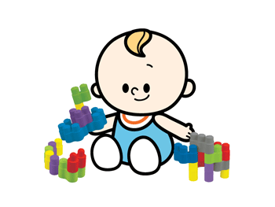
UNIT 8
Where’s Grandma?
Lesson 1: Words

Slide 2
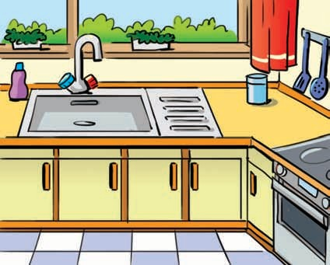
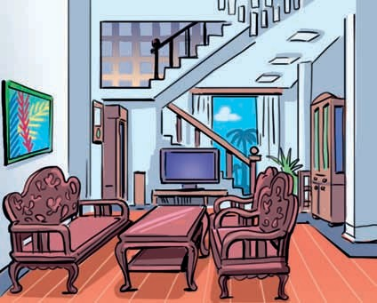
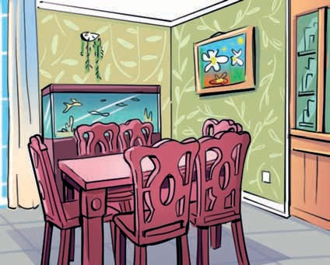
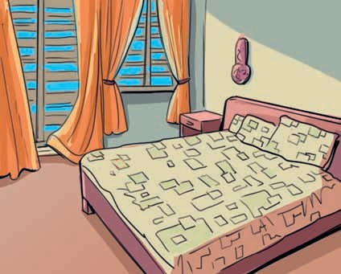
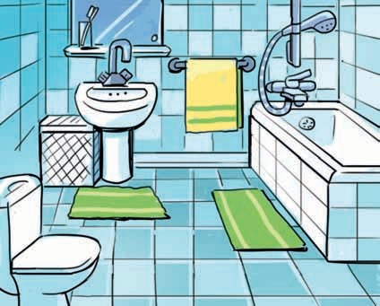
* Listen and repeat
kitchen
living room
dining room
bedroom
bathroom

Slide 3
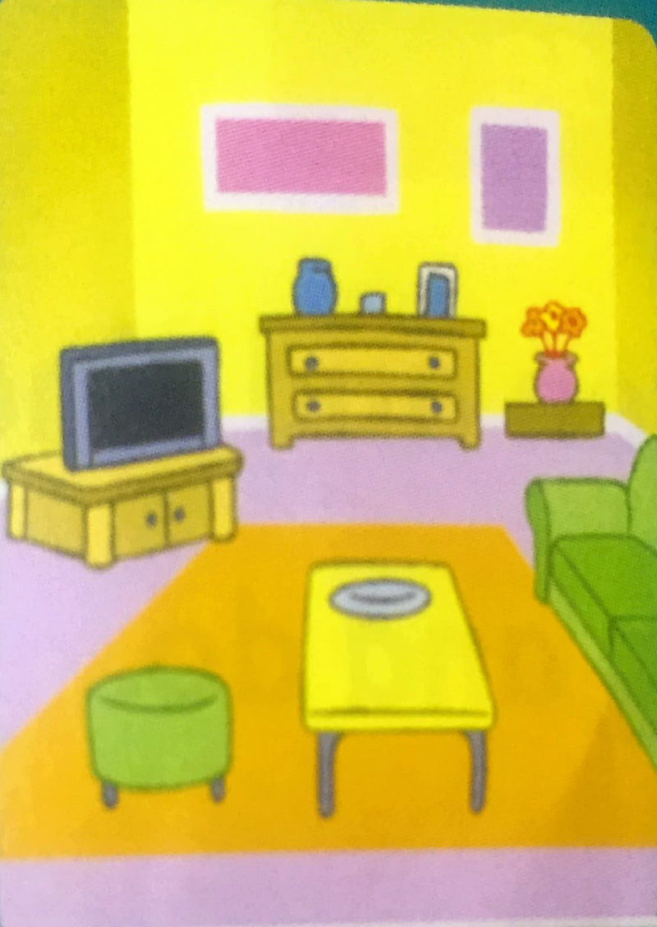
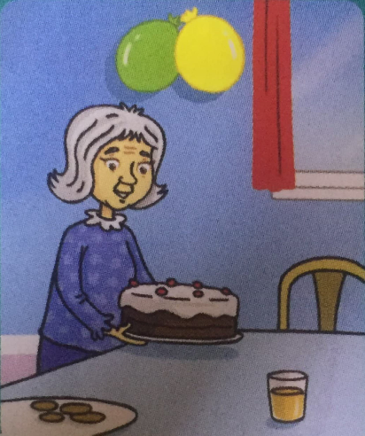
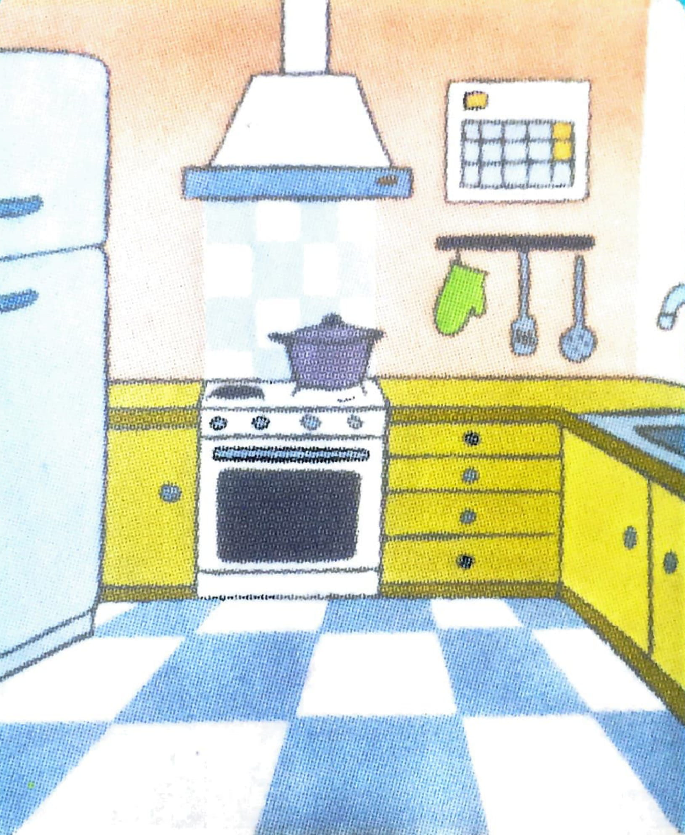
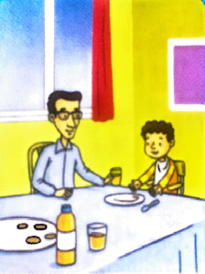
Lesson 2: Grammar
Listen and say
Are they in the living room?
No, they aren’t.
Is she in the kitchen?
No, she isn’t.
Where are Dad and Billy?
They’re in the dining room, too.
Where’s Grandma?
She’s in the dining room.

Slide 4
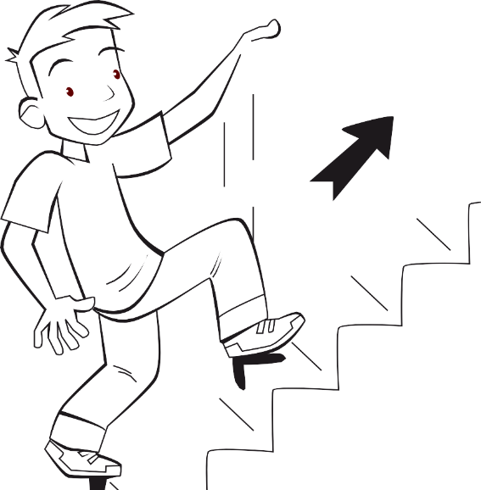
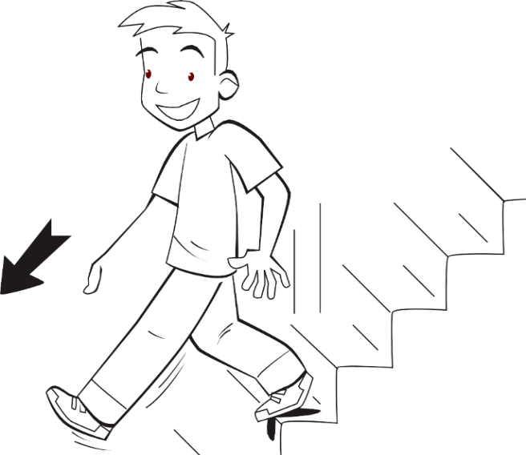
Lesson 3: Song
Listen and repeat
upstairs
apartment
downstairs
house

Slide 5
Lesson 3: Song
Listen and sing

Slide 6
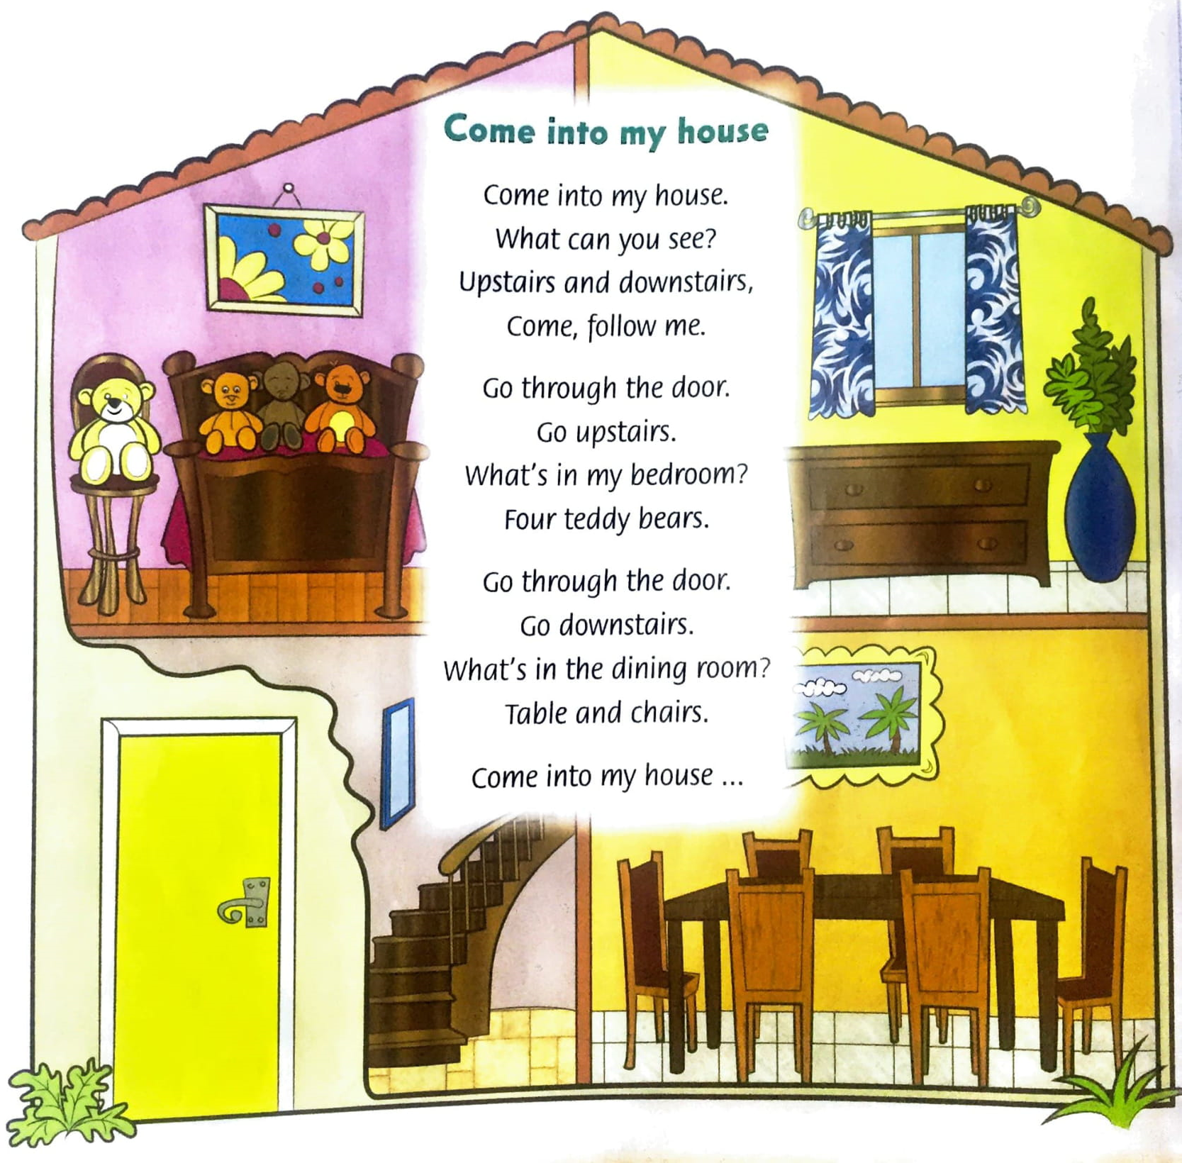

Slide 7
The end of the lesson

Slide 8
Thanks for your attending
GOODBYE

Slide 9
THE END

